Slide 1
Using GitHub
Ali Kadhim
Artificial Intelligence Engineer
For GitHub how-to and workflow example, checkout the repo here: https://github.com/ai-kadhim/practice_repo/

Slide 2
Goals for Today
Learn how to use GitHub
Explore different Git Workflows
Learn how to resolve repo merging conflicts
Explore GitHub Code Spaces
Learn how to use GitHub Actions

Slide 3
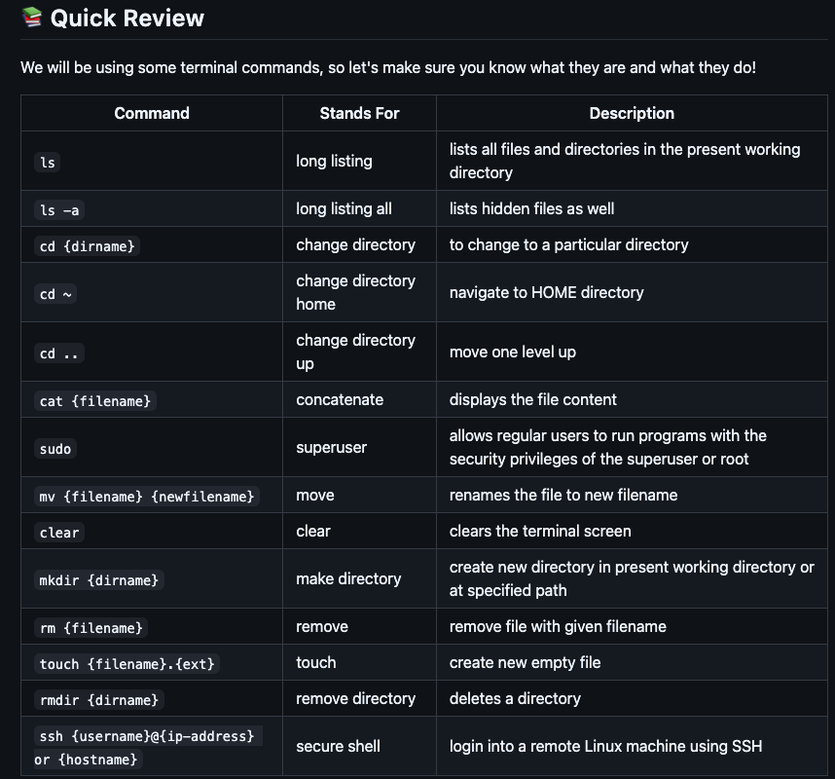

Slide 4

Let’s checkout GitHub!

Slide 5
Questions?

Slide 6

Merging Branches

Slide 7
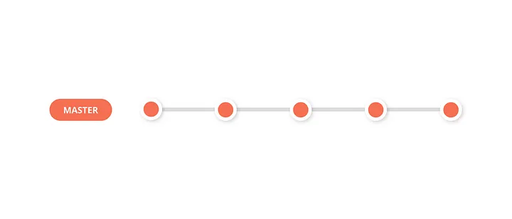
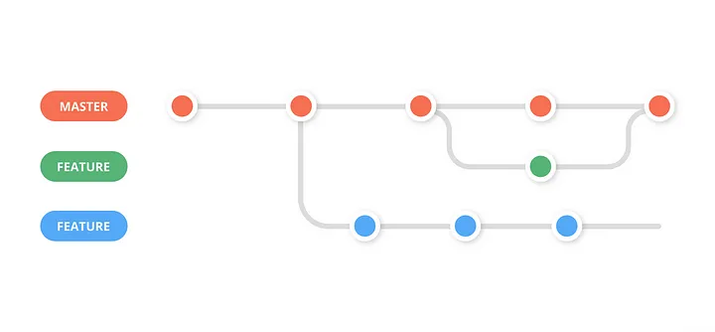
Merging Branches
- Merging is the process of combining changes from one branch into another
- Fundamental part of Git’s branch- based workflow - All team members' contributions are combined into a single codebase
Why Merging: - Integrating a feature branch into the main branch - Incorporating bug fixes, or merging a development branch with new updates
Main

Slide 8
Merging Branches
To merge the specified branch into the current branch:
$ git checkout main
$ git merge feature-branch
Update your local branch with changes from the remote repository:
$ git pull origin main

Slide 9
Merging Branches | Types
Fast-Forward Merge
- No divergence, direct commit
Three-way Merge
- A commit with divergent branches from two parents $ git checkout main
$ git merge feature-branch or force the merge $ git checkout main
$ git merge --no-ff feature-branch
Main

Slide 10
Merging Branches | Conflicts
Git can’t automatically merge because the same line of code has been changed or files have been renamed/deleted between branches.
$ git merge feature-branch
CONFLICT ^ Look at the details of the conflict:
$ git status

Slide 11
Merging Branches | Conflicts
Show the the difference between the current branch and the branch you’re trying to merge
$ git diff List the commits that are causing conflicts:
$ git log --merge

Slide 12
Merging Branches | Resolving Conflict
1 - Open the files and locate conflict markers (<<<<<<<, =======, and >>>>>>>)
2- Edit the file to resolve conflict
3- Remove conflict markers (<<<<<<<, =======, and >>>>>>>)
4- Test the changes by running the application
5 – Commit the resolved changes
$ git add <file>
$ git commit -m "Resolved merge conflict in <file>"

Slide 13
Merging Branches | Resolving Conflict
Handling merge conflicts – Collaborate with your team to make sure they are aware
Avoiding merge conflicts – Pull regularly, rebase when necessary to keep branch up-to-date
$ git pull --rebase origin main
Use meaningful commit messages
git commit -m "Resolved merge conflicts between main and feature-branch for chat model state management"

Slide 14
Questions?

Slide 15
Exploring Different Project Workflows
Main

Slide 16
Centralized Workflow
- Simplest Form
- All developers work directly on the main branch, committing and pushing their changes to a single shared repository.
Use Cases
- Small teams with minimal risk of conflicts.
- Projects where simplicity is more important than managing multiple features at once.
Main
https://svikashk.medium.com/5-git-workflows-you-can-use-to-deliver-better-code-9b8c84e0135f

Slide 17
Git Feature Workflow
- Branches created for each feature or bug fix. - Merged back into the main - Isolates development from the stable codebase
Use Cases
- Working on multiple features simultaneously
- Main branch required to be stable and production-ready
Main
https://svikashk.medium.com/5-git-workflows-you-can-use-to-deliver-better-code-9b8c84e0135f

Slide 18
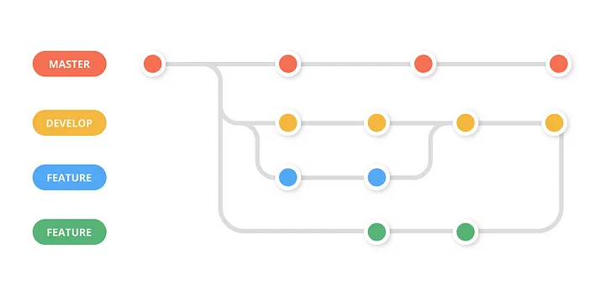
Git Feature Develop Workflow
- Separates development environment from production environment
- Useful when multiple features need to be tested together
Use Cases
- Medium to large teams works on many features simultaneously
- Projects with regular releases requires continuous integration of features
Main
Main
https://svikashk.medium.com/5-git-workflows-you-can-use-to-deliver-better-code-9b8c84e0135f

Slide 19
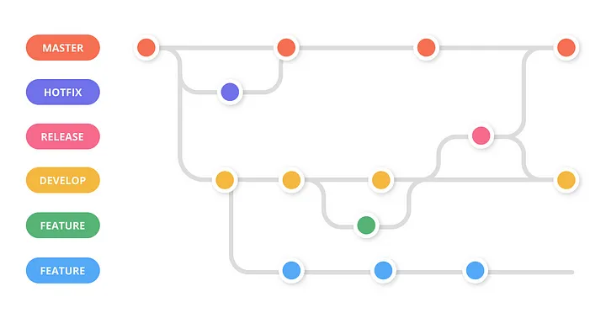
Gitflow Workflow
More complex workflow
Supports multiple types of branches, allowing for parallel development, release management, and hotfixes.
Particularly useful for projects with a defined release cycle.
Use Cases
- Large teams with complex projects.
- Projects with regular releases and the need for maintenance of production and development environments separately
Main
Main
https://svikashk.medium.com/5-git-workflows-you-can-use-to-deliver-better-code-9b8c84e0135f

Slide 20
Questions?
Main

Slide 21

What are Codespaces?

Slide 22
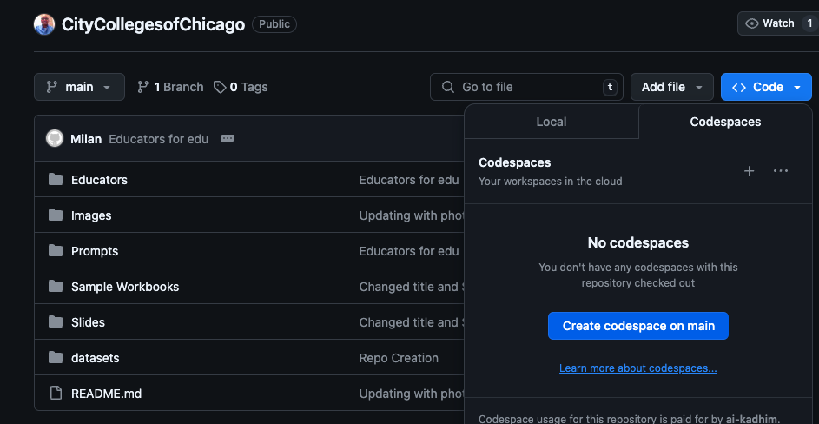
GitHub Codespaces
A cloud-based development environment accessible directly from GitHub
Instant uptime environment
Code, build, test, and run your applications in the cloud.
Particularly useful for projects with a defined release cycle.
Use Cases
- Removes setup time and reduces local machine dependency
- Consistency in development environments across teams

Slide 23
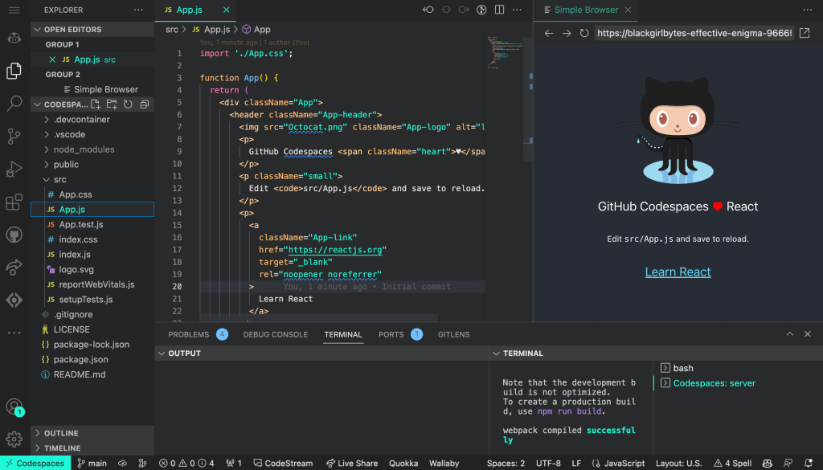
GitHub Codespaces
Pre-configured environments with tools and dependencies.
Run on powerful cloud servers, adjustable based on project needs.
Integrated Development: Works seamlessly with Visual Studio Code and GitHub.
Customizable: Configure using .devcontainer
Portability: Access your environment from anywhere

Slide 24
Let’s Explore Codespaces!

Slide 25
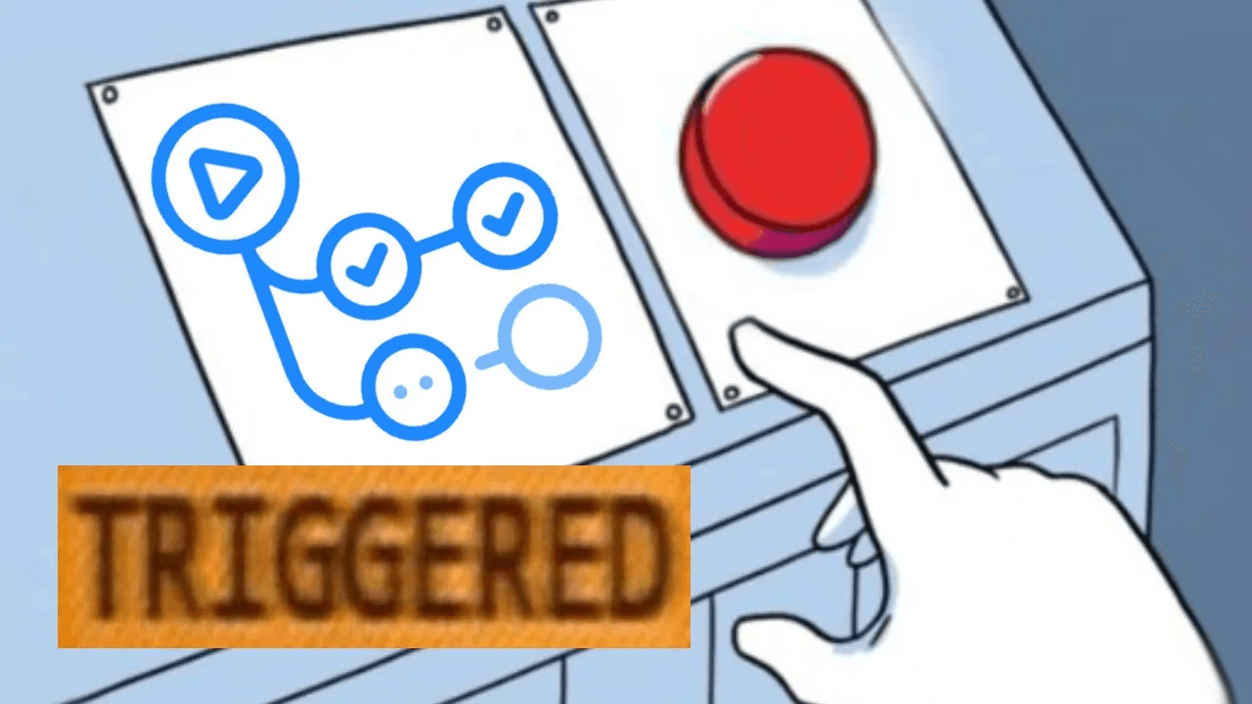
Let’s dive into GitHub Action Workflows!

Slide 26
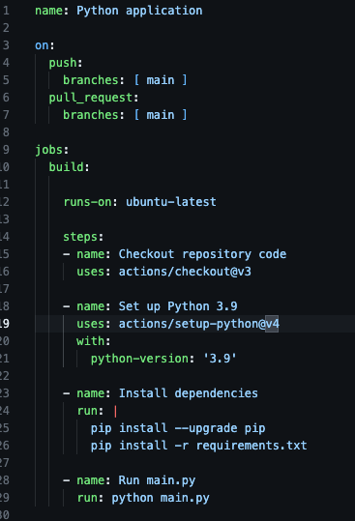

GitHub Actions
Automate, customize, and execute workflow with the repo
Set up Continuous Integration/Continuous Deployment (CI/CD) pipelines
Trigger on events (e.g. push, pr)
Infrastructure as Code (IaC)
https://github.com/actions

Slide 27
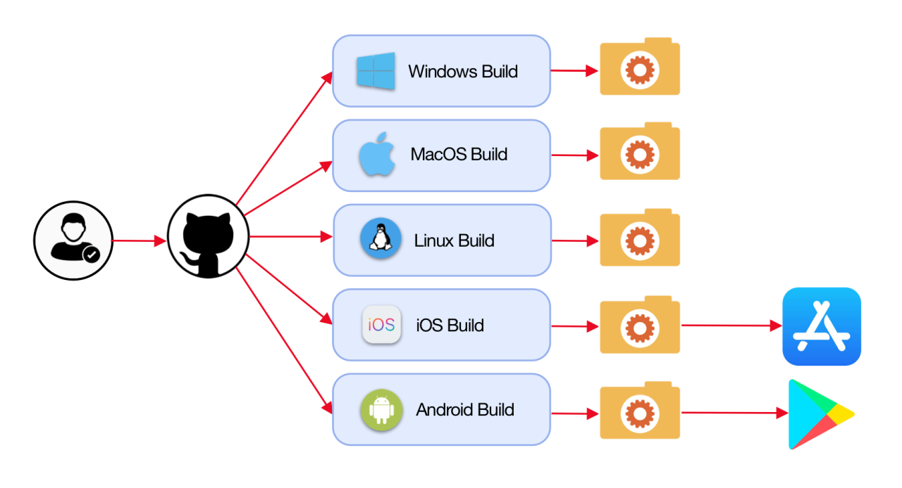
GitHub Actions
Code quality check
Build and release management
Multi-os releases
Testing and validation
Utilize Prebuilt Actions on the marketplace
https://www.linkedin.com/pulse/what-github-actions-benefits-examples-srinivas-prasad-k-t-5qmfc/

Slide 28
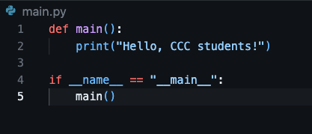
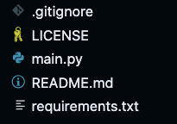
GitHub Actions | Example Project
Basic format hello world application
File structure
How do we verify our code on the repo will execute without errors?
main.py

Slide 29
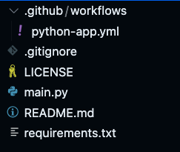
GitHub Actions | Creating the YAML File
Creating the workflow directory:
$ mkdir -p .github/workflows
Create the YAML (workflow) file:
$ touch .github/workflows/python-app.yml

Slide 30
GitHub Actions | Code
Understanding the workflow structure:
name label assigned to each process in the workflow
on Specifies the events triggering the workflow
jobs Collection of jobs executed in the workflow
Steps A series actions executed within a job

Slide 31
GitHub Actions | Code
Understanding the workflow structure:
build Initiates a job with instructions following
Runs-on uses an environment from the GitHub database
uses calls for a GitHub action code template with version
run a terminal command to be executed
https://github.com/actions/checkout

Slide 32
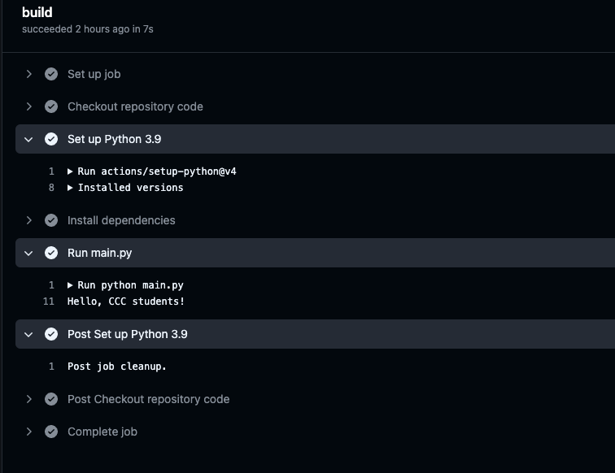
GitHub Actions | Results on Push

